Slide 1
Argumentative Essay
Notes:
Adapted from: Reading and Writing Arguments - ppt download. (n.d.). Slideplayer. Retrieved April 16, 2020, from https://slideplayer.com/slide/13074964/
1

Slide 2
Argumentative Essay
The aim of writing argumentative essays is to convince or persuade the reader.
It changes the reader’s mind and convince the reader to agree with the point of view or claim of the writer.
So an argumentative essay needs to be highly persuasive and logical.

Slide 3
What is an argument?
An argument is a persuasive text that presents reasons for accepting a belief or a position.

Slide 4
What is an argument?
An argumentative text is a text, that uses evidence and facts to support the claim it’s making. Its purpose is to persuade the reader to agree with the argument being made.

Slide 5
3 Parts of an Argument*
Issue- the problem or controversial topic
Claim- the author’s point of view on the issue, for/against?
Support- these are details the writer uses to persuade the reader to accept his/her claim.
Ex. Reasons, evidence, statistics, etc.

Slide 6
Argumentative Text
A good argumentative text will use facts and evidence to support the argument, rather than just the author’s thoughts and opinions. For example, you wanted to write an argumentative essay stating that sea side is a great destination for families. You couldn’t just say that it’s a great place because you took your family there and enjoyed it. For it to be an argumentative essay, you need to have facts and data to support your argument, such as the number of child-friendly attractions in sea side, special deals you can get with kids, and surveys of people who visited sea side as a family and enjoyed it. The first argument is based entirely on feelings, whereas the second is based on evidence that can be proven.

Slide 7
Types of Support
Facts
Statistics
Quotations and Citations
Examples
Personal Experience
Comparison and Analogies

Slide 8
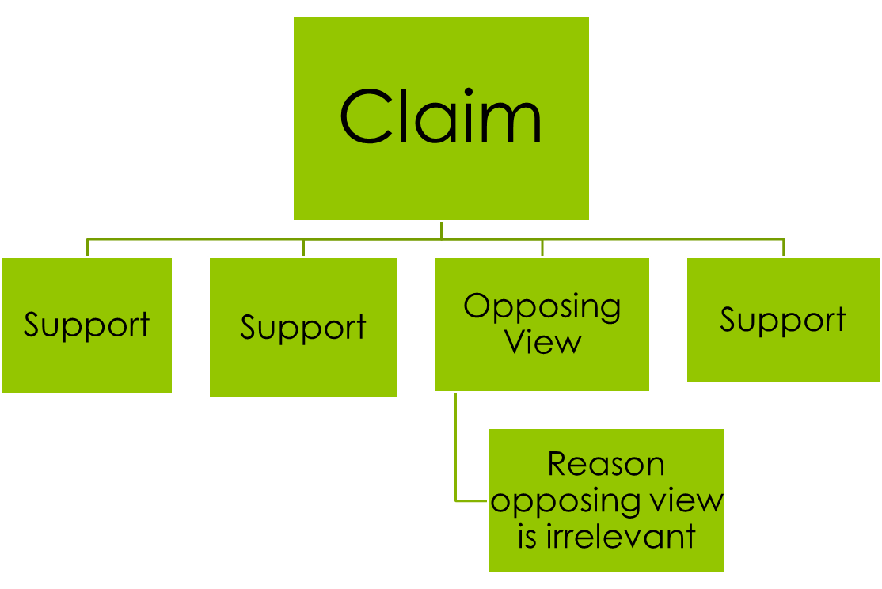
Structure of an Argument

Slide 9
Refutation*-The 4th Part of an Argument
4. Good arguments not only provide justifications why the reader should accept the individual’s point of view, but they also indicate what the opposing idea might be and why that viewpoint is irrelevant.

Slide 10
Counterargument and Refutation
Counterargument – at least one paragraph which explains the opposite point of view
Concession – a sentence or two acknowledging that there could be some truth to the Counterargument
Refutation (also called Rebuttal) – sentences which explain why the Counterargument is not as strong as the original Argument

Slide 11
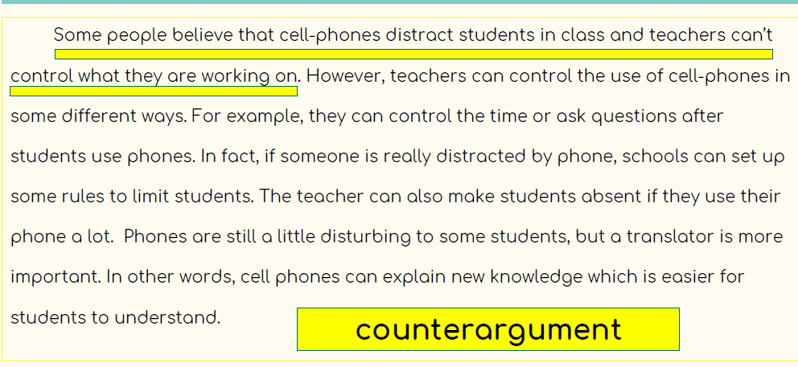

Slide 12
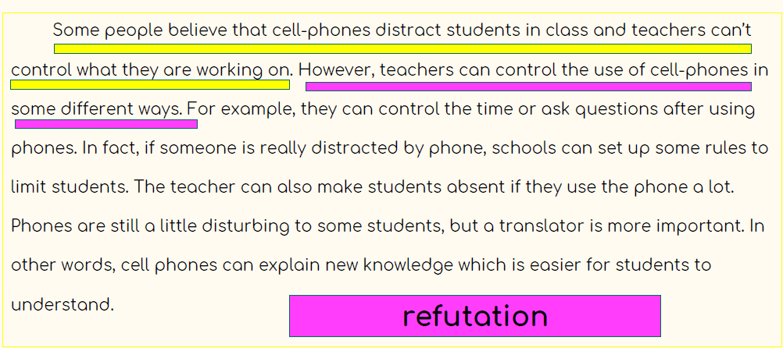

Slide 13
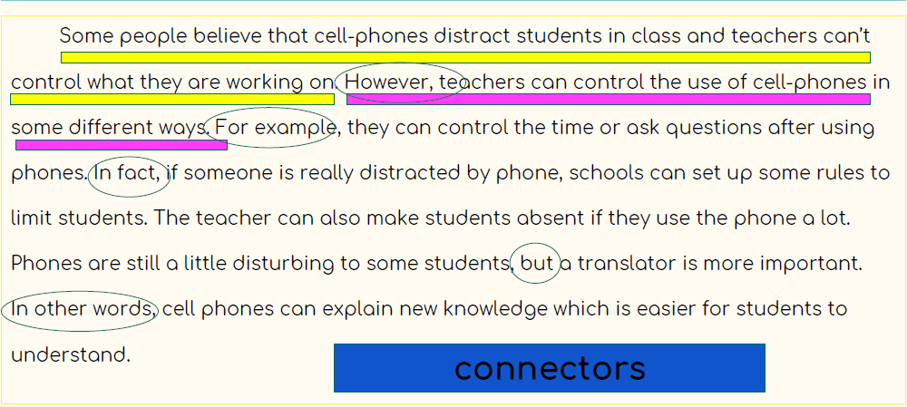

Slide 14
Counter-Argument and Refutation
Halloween is the best holiday. (Claim)
A dentist might say that Halloween candy is bad for kids’ teeth. (Counter-Argument)
But research shows that, with regular brushing and flossing, occasional treats will not negatively affect a person’s dental health. (Refutation)

Slide 15
Introducing Counter Argument
Some people feel that …,
Many think that …,
Opponents say that …,
Some researchers argue that …

Slide 16
Expression for Refutation (Writer’s response to the other’s side support)
However, I disagree with their opinion……
My response to that argument is……..
In response, I would say…..
There is a problem with that argument…..

Slide 17
Some may argue that advertisements are beneficial. It is the contention of these supporters that advertisements are essential in keeping the market alive and rivalry hot. They believe that it is thanks to advertisements that companies working on the same line can display their products on the market equally and fairly. However, this idea cannot go further than being an immature claim because this rivalry is unfair. It is only the companies who can “afford” broadcasting strong propaganda of their product that can actually survive in this competitive environment. In that sense, small companies are destined to be wiped out from the market.

Slide 18
Those who oppose the idea of imposing higher taxes on the wealthy often refer to the concept of trickle-down economics.The key idea of trickle-down economic theory is that when the wealthy gain benefits, these trickle down to everyone else in the economy. These benefits are usually in the form of tax cuts for high-income earners and businesses. The belief is that the money gained from tax cuts will be pumped back into the economy through investments that will ultimately create more jobs and income for everyone. On the surface this argument seems quite logical. However, this theory is being rejected by many, including the International Monetary Fund (IMF).Their research suggests that when the top 20% become wealthier, this does not have a significantly positive impact on the economy. In contrast, they found that more economic growth is generated by increasing the incomes of low to middle-income earners. For instance, increasing the wealth of just one-fifth of low-income earners by 1% results in about a 0.4% increase in economic growth, whereas an increase in wealth for the top 20% only results in about a 0.1% increase in growth. Thus, it can be concluded that cutting taxes for the rich does not have wider benefits for all.

Slide 19
Yet, some readers may challenge that basing medical end-of-life decisions on patient consent may lead to abuse, since many terminally ill patients are depressed, and, therefore, unable to make sound decisions on matters of such significance. While it is true that such patients may have a greater tendency to depression, we cannot justifiably assume all patients are depressed, or that depression, even when present, prevents a patient from consenting in a balanced and acceptable way. Depression is generally manageable nowadays, and a medical diagnosis can determine when a person is incapable of making such a decision. The issue of depression, therefore, should be dealt with on a case-by-case basis, and not be a reason for prohibiting choice in general

Slide 20
Writer’s opinion: I feel that camping in tent is better that staying in a hotel room
Other’s side argument and refutation
On the other hand, some people think that staying in hotel room is better________________________ it is quieter. However, I disagree with their opinion. In most hotel that have stayed in, ______________________________ from the other rooms. Often this noise continues until _____________________. However, the sounds that I hear during camping are sounds of nature which, __________________________.

Slide 21
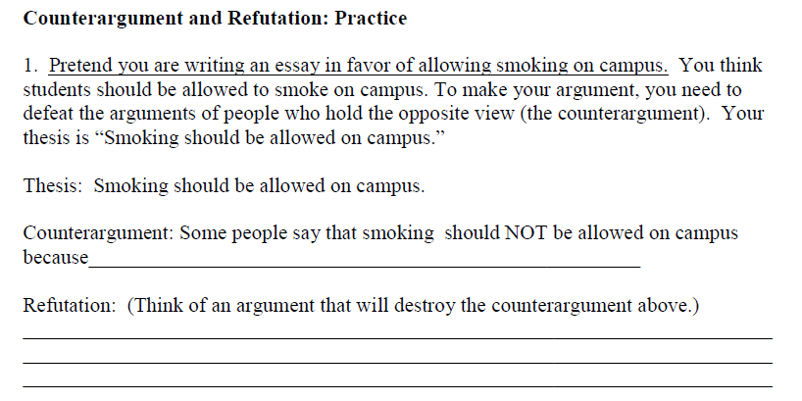

Slide 22
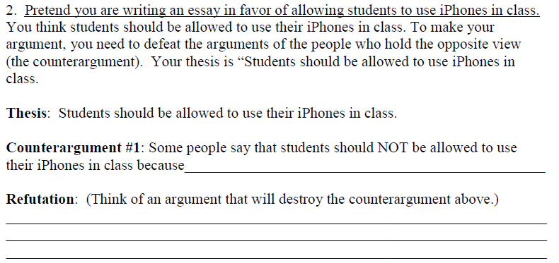

Slide 23
Argumentative Essay

Slide 24
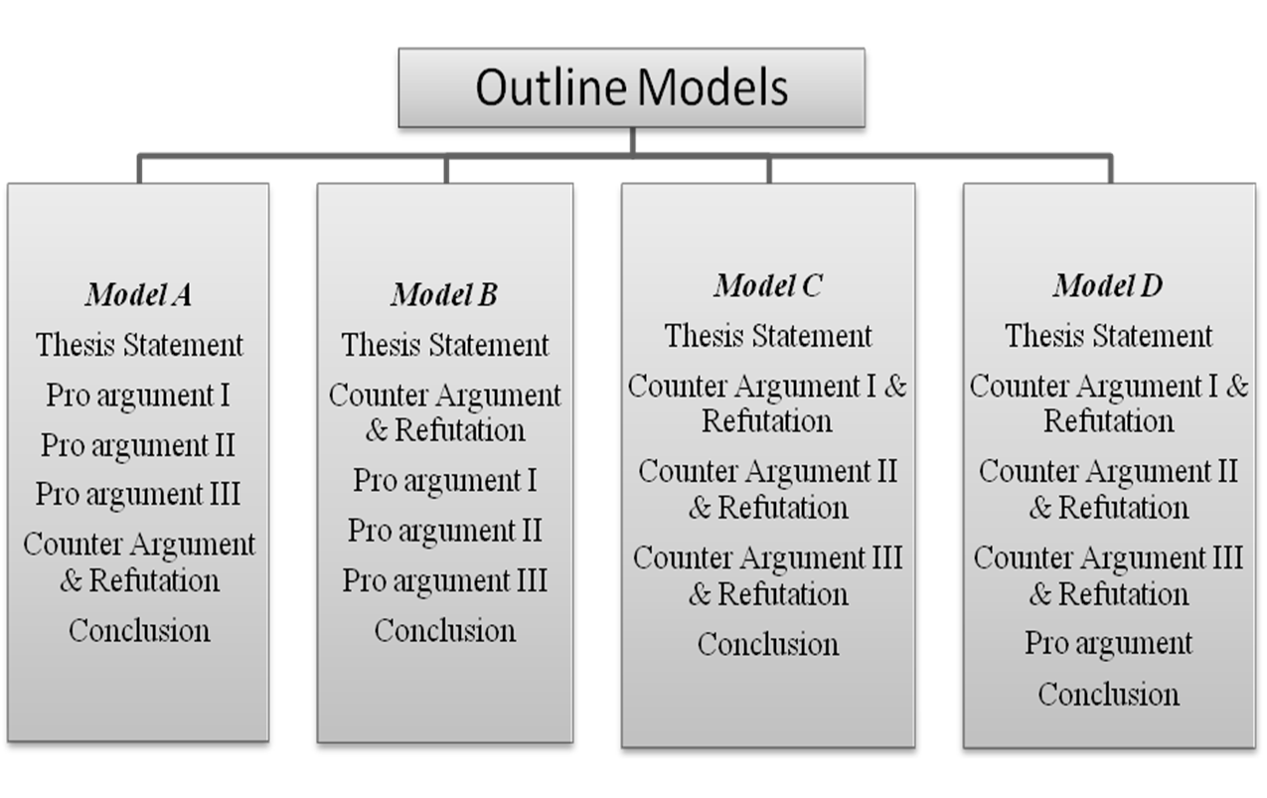

Slide 25
Topic for essay
Is fashion really important?
Can smoking be prevented by making tobacco illegal?

Slide 26
Reading Arguments Review
What is an argument and how can it be identified?
What are the elements of a good argument?
What is a biased viewpoint and how does this impact an argument?
Does it matter what type of support is used, why/why not?
How does an individual’s background influence the argument?

Slide 27
Thank You

